Slide 1

IoT · IoTFlow
COURSE SLIDES · WSQ
Business Innovation with Internet-of-Things (IoT)
WSQ Course Code: TGS-2026064711
Conducted by Tertiary Infotech Academy Pte Ltd · UEN 201200696W
Version v10.1 · 11 August 2026
© 2026 Tertiary Infotech Academy Pte Ltd. All rights reserved. · www.tertiarycourses.com.sg

Slide 2
COURSE ADMINISTRATION
Welcome & Housekeeping
Business Innovation with IoT · TGS-2026064711
© 2026 Tertiary Infotech Academy Pte Ltd
2

Slide 3
TRAQOM · SSG DIGITAL ATTENDANCE
Digital Attendance (Mandatory)
1
2
3
▶
▶
MORNING (AM)
Scan on arrival
AFTERNOON (PM)
Scan after lunch
ASSESSMENT
Scan before you begin
Business Innovation with IoT · TGS-2026064711
© 2026 Tertiary Infotech Academy Pte Ltd
3

Slide 4
TRAQOM · SSG DIGITAL ATTENDANCE
How Digital Attendance Works
Mandatory for WSQ funding
AM, PM and Assessment attendance must all be taken for WSQ-funded courses.
The QR code
The trainer or administrator displays the QR code generated from the SSG portal.
1
2
How to submit
Scan the QR code with your mobile phone camera and submit your attendance.
75% minimum
At least 75% attendance is required to be eligible for assessment and funding.
3
4
Business Innovation with IoT · TGS-2026064711
© 2026 Tertiary Infotech Academy Pte Ltd
4

Slide 5
YOUR TRAINER · GENERAL
About the Trainer
NAME
____________________________________________
?
TITLE / DESIGNATION
____________________________________________
QUALIFICATIONS
____________________________________________
Your Trainer
AREAS OF EXPERTISE
____________________________________________
General Trainer template —
to be completed by the trainer
TRAINING & INDUSTRY EXPERIENCE
____________________________________________
CONTACT
____________________________________________
Business Innovation with IoT · TGS-2026064711
© 2026 Tertiary Infotech Academy Pte Ltd
5

Slide 6
YOUR TRAINER
About the Trainer
ROLE
Principal Trainer, Tertiary Infotech Academy Pte Ltd
AA
EXPERTISE
Internet of Things, digital transformation and business innovation.
Dr. Alfred Ang
DELIVERS
WSQ courses on IoT, AI, data analytics and emerging digital technology.
Principal Trainer
Tertiary Infotech Academy Pte Ltd
FOUNDER
Founder and lead instructor at Tertiary Infotech / Tertiary Courses.
Business Innovation with IoT · TGS-2026064711
© 2026 Tertiary Infotech Academy Pte Ltd
6

Slide 7
ICE-BREAKER
Let's Know Each Other
• Your name, organisation and role.
• How your organisation uses (or could use) connected devices and sensor data today.
• One business problem you would like IoT to solve by the end of today.
Business Innovation with IoT · TGS-2026064711
© 2026 Tertiary Infotech Academy Pte Ltd
7

Slide 8
HOUSEKEEPING
Ground Rules
Set your mobile phone to silent mode.
Participate actively — no question is too small.
1
2
Mutual respect: agree to disagree.
One conversation at a time.
3
4
Be punctual; return from breaks on time.
75% attendance is required.
5
6
Business Innovation with IoT · TGS-2026064711
© 2026 Tertiary Infotech Academy Pte Ltd
8

Slide 9
COURSE PORTAL
Download Your Course Material
🔒 lms-tms.tertiaryinfotech.com
Go to lms-tms.tertiaryinfotech.com
Open the portal in any browser.
1
Tertiary Infotech · LMS / TMS
Log in with your registered email
The same address used to enrol.
2
MY COURSES
Business Innovation with Internet-of-Things (IoT)
TGS-2026064711
Open this course
Business Innovation with IoT.
3
PDF
Learner Slides
⤓ Download
Download the material
Slides, Learner Guide and Lesson Plan.
4
PDF
Learner Guide
⤓ Download
Lesson Plan
Keep them open in class
The assessment is open book.
PDF
⤓ Download
5
Business Innovation with IoT · TGS-2026064711
© 2026 Tertiary Infotech Academy Pte Ltd
9

Slide 10
SKILLS FRAMEWORK FOR INFOCOMM TECHNOLOGY
Skills Framework — TSC
TSC Title
Business Innovation
TSC Code
ICT-SNA-4003-1.1
1
2
Category
Business and Project Management
Proficiency
Level 4 — Explore opportunities for business innovation and reform, and lead the implementation of innovative business initiatives.
3
4
Business Innovation with IoT · TGS-2026064711
© 2026 Tertiary Infotech Academy Pte Ltd
10

Slide 11
WHAT THIS COURSE DEVELOPS · A1–A5
TSC Abilities — Assessed by the Written Assessment
1
A1
Compare current business model for the organisation with the other business models in the industry
2
A2
Explore potential opportunities for business innovation to be introduced within the organisation
3
A3
Identify ways in which digitisation can be applied to the business
4
A4
Conduct feasibility analysis and weigh the costs-benefits of potential business innovation opportunities
5
A5
Implement business innovation processes in line with a defined action plan
Business Innovation with IoT · TGS-2026064711
© 2026 Tertiary Infotech Academy Pte Ltd
11

Slide 12
WHAT THIS COURSE DEVELOPS · K1–K4
TSC Knowledge — Assessed by Oral Questioning
1
K1
New and emerging innovative business processes / models deployed in the industry
2
K2
Concept and principles of digitisation
3
K3
Factors to consider to assess the viability of business innovation for a given organisation context
4
K4
Success factors for implementation of business innovation
Business Innovation with IoT · TGS-2026064711
© 2026 Tertiary Infotech Academy Pte Ltd
12

Slide 13
SCHEDULE · 9:30am – 6:30pm
Lesson Plan — 1 Day, 8 hours
Morning · 9:30am – 12:30pm
Afternoon · 1:30pm – 6:30pm
– Digital Attendance (AM) · Introductions
– Topic 1: Overview of IoT (LO1)
– Topic 2: Potential Opportunities of IoT (LO2)
– Topic 3: IoT Technology — concepts (LO3)
– Lunch Break — 1 hour
– Digital Attendance (PM)
– Topic 3: Hands-On Practical — Labs 1–4 (90 min)
– Topic 4: IoT Adoption (LO4)
– Topic 5: IoT Implementation (LO5)
– TRAQOM Survey · Digital Attendance (Assessment)
– Final Assessment — WA (75 min) + OQ (15 min)
Business Innovation with IoT · TGS-2026064711
© 2026 Tertiary Infotech Academy Pte Ltd
13

Slide 14
WHAT YOU'LL ACHIEVE
Learning Outcomes
1
LO1 · Compare business models
Compare your current business model with emerging IoT-enabled models. (A1, K1)
2
LO2 · Explore opportunities
Explore potential opportunities for business innovation using IoT. (A2, K1)
3
LO3 · Identify how IoT works
Identify how IoT works and how digitisation applies to the business. (A3, K2)
4
LO4 · Weigh costs & benefits
Conduct a feasibility analysis and weigh the costs and benefits of IoT. (A4, K3)
5
LO5 · Implement with a plan
Implement business innovation processes with IoT to a defined action plan. (A5, K4)
Business Innovation with IoT · TGS-2026064711
© 2026 Tertiary Infotech Academy Pte Ltd
14

Slide 15
FIVE TOPICS · ONE DAY
Course Outline
1
Topic 1 — Overview of IoT
Industry 4.0, IoT business models, sensors and actuators, wireless technologies.
2
Topic 2 — Potential Opportunities
Agriculture, autonomous vehicles, logistics, smart buildings, healthcare, drones.
3
Topic 3 — IoT Technology
Cloud platforms, posting data, remote control, analytics, automation + 4 hands-on labs.
4
Topic 4 — IoT Adoption
Adoption challenges, IoT security, edge computing, cost-benefit analysis.
5
Topic 5 — IoT Implementation
Success factors, design thinking, a 7-step implementation action plan.
Business Innovation with IoT · TGS-2026064711
© 2026 Tertiary Infotech Academy Pte Ltd
15

Slide 16
BEFORE YOU BEGIN
Briefing for Assessment
Place phones and other materials under the table or on the floor.
No photos or recording of assessment scripts.
1
2
No discussion during the assessment.
Use a black or blue pen for hard-copy assessments.
3
4
No liquid paper or correction tape.
Scripts are collected when the time is up.
5
6
Business Innovation with IoT · TGS-2026064711
© 2026 Tertiary Infotech Academy Pte Ltd
16

Slide 17
ASSESSMENT · 90 MINUTES TOTAL
Final Assessment
WA (Q&A) — 75 min
OQ — 15 min
What you may use
• Short-answer questions
• Assesses abilities A1–A5
• 15 minutes per ability
• Open book
• Oral questioning
• Assesses knowledge K1–K4
• 1:1 with the assessor
• Open book
• The course slides
• Your Learner Guide
• Approved materials only
• An appeal process is available
Business Innovation with IoT · TGS-2026064711
© 2026 Tertiary Infotech Academy Pte Ltd
17

Slide 18
ON ASSESSMENT DAY
Assessment Flow
1
2
3
4
5
▶
▶
▶
▶
TRAQOM survey — scan the QR code on the LMS
Assessment digital attendance — scan the SSG QR
Sit the WA (Q&A) — 75 min, open book
Oral Questioning — 15 min, 1:1 with the assessor
Sign the Assessment Summary Record
Business Innovation with IoT · TGS-2026064711
© 2026 Tertiary Infotech Academy Pte Ltd
18

Slide 19
01
TOPIC 01
Overview of Internet of Things (IoT)
Industry 4.0 · IoT business models · Sensors & actuators · Wireless technologies
Business Innovation with IoT · TGS-2026064711
© 2026 Tertiary Infotech Academy Pte Ltd
19

Slide 20
WHY NOW
We are in the 4th Industrial Revolution.
AI + IoT + 5G + Cloud + Robotics are converging — physical assets now report their own state in real time.
Business Innovation with IoT · TGS-2026064711
© 2026 Tertiary Infotech Academy Pte Ltd
20

Slide 21
LO1 · A1, K1 · 60 min
Key Concepts — Overview of Internet of Things (IoT)
Industry 4.0
IoT, AI, 5G, cloud and robotics converge so physical assets report their own state in real time.
What IoT is
Connecting everyday objects to the internet to cut cost, lift productivity and open new revenue.
1
2
The four building blocks
Sensors/devices capture data, connectivity moves it, cloud processes it, a UI acts on it.
Why now
Cheap sensors, long-range low-power wireless and 5G removed the cost barrier to mass adoption.
3
4
Product to service
IoT shifts firms from one-off product sales to subscription, outcome and pay-per-use models.
Data as the asset
The recurring value is the telemetry stream, not the device — it compounds over time.
5
6
Business Innovation with IoT · TGS-2026064711
© 2026 Tertiary Infotech Academy Pte Ltd
21

Slide 22
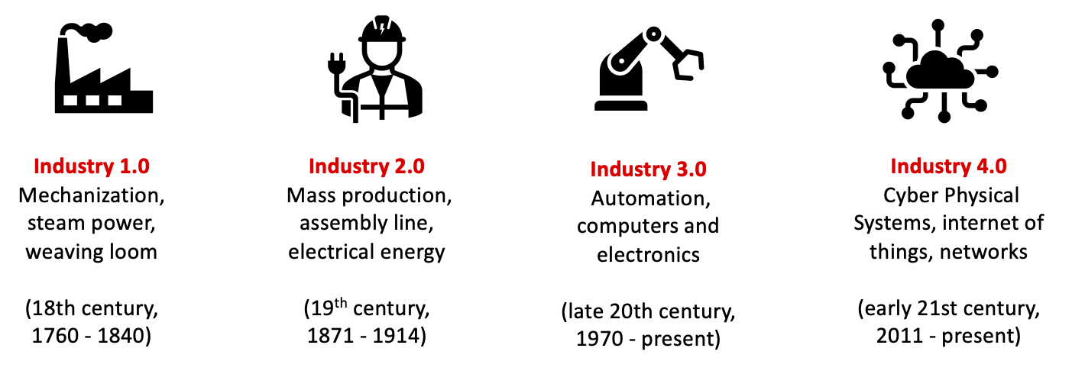
TOPIC 01 · CONTEXT
The Fourth Industrial Revolution
Industry 4.0 — cyber-physical systems, IoT, cloud computing and cognitive computing.
Business Innovation with IoT · TGS-2026064711
© 2026 Tertiary Infotech Academy Pte Ltd
22

Slide 23
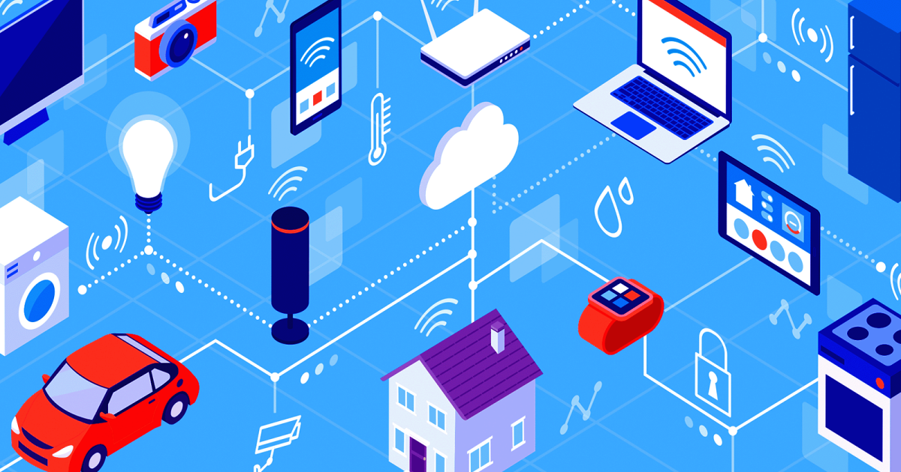
TOPIC 01 · DEFINITION
What Is the Internet of Things?
IoT connects everyday objects to the internet so they can send and receive data.
Business Innovation with IoT · TGS-2026064711
© 2026 Tertiary Infotech Academy Pte Ltd
23

Slide 24
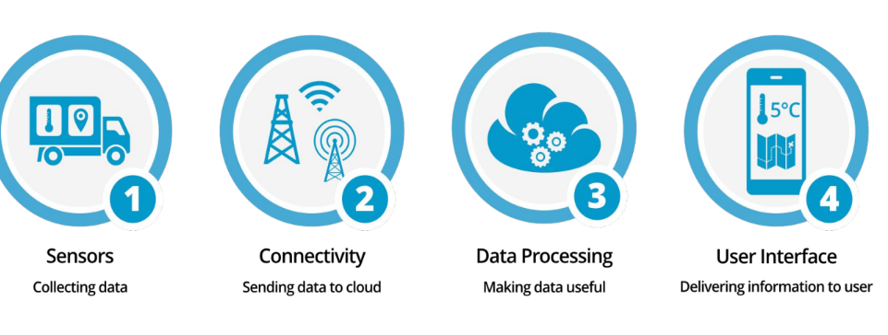
TOPIC 01 · COMPONENTS
The Components of an IoT System
A 'thing' is any object with embedded electronics that transfers data over a network.
Business Innovation with IoT · TGS-2026064711
© 2026 Tertiary Infotech Academy Pte Ltd
24

Slide 25
THE OPPORTUNITY
The Scale of IoT
$9T
50B+
4th
5G
Estimated IoT market value
Connected devices worldwide
Industrial revolution underway
The accelerator to mass adoption
Business Innovation with IoT · TGS-2026064711
© 2026 Tertiary Infotech Academy Pte Ltd
25

Slide 26
THE IoT ARCHITECTURE
How IoT Works — The Four Building Blocks
1
2
3
4
▶
▶
▶
SENSORS & DEVICES capture data from the physical world
CONNECTIVITY carries it over WiFi, cellular, LoRa or MQTT
CLOUD stores, processes and analyses the data
USER INTERFACE shows insight and sends commands back
Business Innovation with IoT · TGS-2026064711
© 2026 Tertiary Infotech Academy Pte Ltd
26

Slide 27
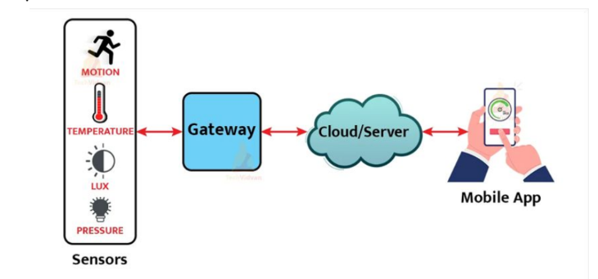
TOPIC 01 · ARCHITECTURE
How IoT Works
Sensors and devices talk to the cloud; software processes the data and acts, or shows it to a user.
Business Innovation with IoT · TGS-2026064711
© 2026 Tertiary Infotech Academy Pte Ltd
27

Slide 28
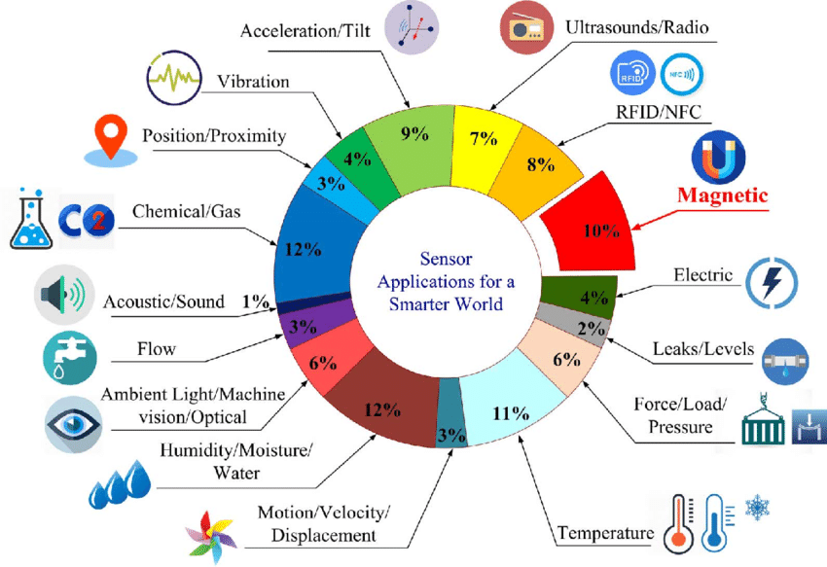
TOPIC 01 · SENSORS
Sensors for IoT
Low-cost sensors are what made large-scale IoT deployment economically viable.
Business Innovation with IoT · TGS-2026064711
© 2026 Tertiary Infotech Academy Pte Ltd
28

Slide 29
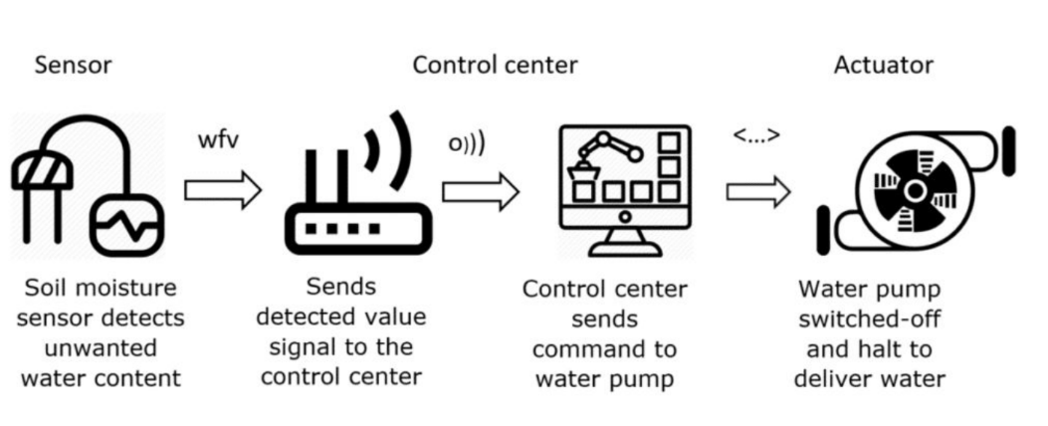
TOPIC 01 · ACTUATORS
Actuators for IoT
Actuators turn a decision in the cloud back into a physical action.
Business Innovation with IoT · TGS-2026064711
© 2026 Tertiary Infotech Academy Pte Ltd
29

Slide 30
THE PHYSICAL LAYER
Sensors, Actuators and Gateways
Sensors — sense
Actuators — act
Gateways — connect
• Temperature & humidity
• Motion, presence, vibration
• Light, gas, air quality
• GPS location, current
• Relays and switches
• Motors and servos
• Valves and pumps
• Alarms and displays
• Aggregate nearby devices
• Translate protocols
• Buffer when offline
• Add edge processing
Business Innovation with IoT · TGS-2026064711
© 2026 Tertiary Infotech Academy Pte Ltd
30

Slide 31
CONNECTIVITY CHOICES
Wireless Technologies for IoT
WiFi
High bandwidth, short range, mains power — best indoors where power is available.
Bluetooth / BLE
Very low power, very short range — wearables and personal devices.
1
2
Cellular (4G/5G)
Wide coverage with a subscription cost — vehicles, logistics and remote assets.
LoRaWAN / NB-IoT
Long range, very low power, tiny payloads — agriculture, metering, city-scale sensing.
3
4
Zigbee / Z-Wave
Low-power mesh — smart buildings and home automation.
Choosing one
Trade range against power, bandwidth and cost — there is no single best option.
5
6
Business Innovation with IoT · TGS-2026064711
© 2026 Tertiary Infotech Academy Pte Ltd
31

Slide 32
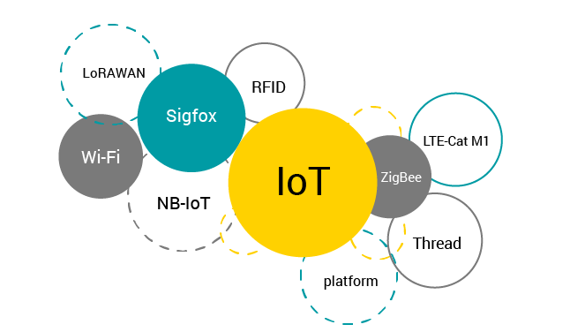
TOPIC 01 · CONNECTIVITY
Wireless Technologies for IoT
Range, power consumption, bandwidth and cost determine which technology fits a use case.
Business Innovation with IoT · TGS-2026064711
© 2026 Tertiary Infotech Academy Pte Ltd
32

Slide 33
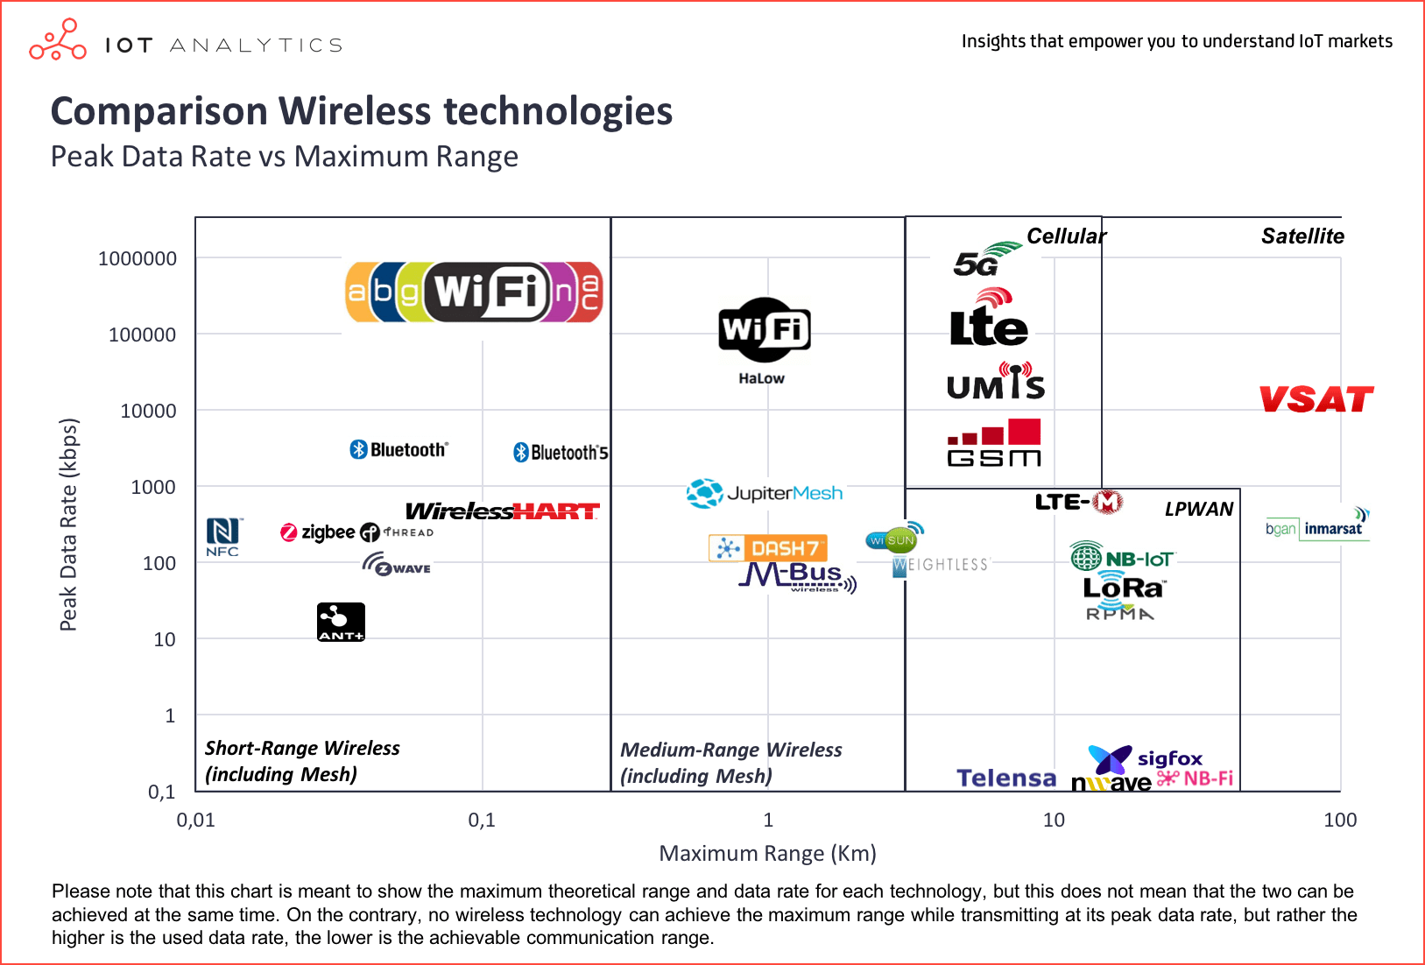
TOPIC 01 · CONNECTIVITY
Comparing Wireless Technologies
There is no single best option — every choice trades range against power and bandwidth.
Business Innovation with IoT · TGS-2026064711
© 2026 Tertiary Infotech Academy Pte Ltd
33

Slide 34
A1 · HOW IoT CHANGES THE BUSINESS MODEL
New Business Models Enabled by IoT
Product → Service
Sell the outcome (cooling, uptime, mobility) rather than the machine itself.
Subscription
Recurring revenue for monitoring, analytics and support built on the data stream.
1
2
Pay-per-use
Charge by actual consumption, measured by the device — fair for the customer, predictable for you.
Predictive maintenance
Service before failure; convert unplanned downtime into scheduled work.
3
4
Data-driven products
The telemetry itself becomes a product — benchmarking, insurance, optimisation.
Ecosystem platforms
Open the data to partners and earn from the platform, not just the device.
5
6
Business Innovation with IoT · TGS-2026064711
© 2026 Tertiary Infotech Academy Pte Ltd
34

Slide 35
TOPIC 01 · ACTIVITY
Discussion — Compare Business Models
DISCUSSION · 15 MIN
In pairs, describe how your organisation earns revenue today. Then pick one IoT-enabled competitor or industry example and compare the two.
1
2
3
4
How does your organisation make money today — product sale, project fee, subscription?
Which IoT-enabled model could apply: outcome-based, pay-per-use, subscription, or predictive service?
What data would you need to collect before that model becomes possible?
What would customers gain, and what would they be willing to pay for?
YOUR OUTPUT A short written comparison of your current model against one IoT-enabled model.
Business Innovation with IoT · TGS-2026064711
© 2026 Tertiary Infotech Academy Pte Ltd
35

Slide 36
TOPIC RECAP
Recap — Overview of Internet of Things (IoT)
• IoT connects physical assets to the internet so they report their own state.
• Four building blocks: sensors/devices, connectivity, cloud, user interface.
• Falling sensor cost, low-power wireless and 5G made mass adoption viable.
• IoT shifts firms from product sales to service, subscription and outcome models.
Business Innovation with IoT · TGS-2026064711
© 2026 Tertiary Infotech Academy Pte Ltd
36

Slide 37
02
TOPIC 02
Potential Opportunities of IoT Innovation
Agriculture · Autonomous vehicles · Logistics · Smart buildings · Healthcare · Drones
Business Innovation with IoT · TGS-2026064711
© 2026 Tertiary Infotech Academy Pte Ltd
37

Slide 38
THE OPPORTUNITY LANDSCAPE
IoT has reached every industry.
From agriculture to aerospace — the pattern is always the same: sense something that used to be invisible, then act on it.
Business Innovation with IoT · TGS-2026064711
© 2026 Tertiary Infotech Academy Pte Ltd
38

Slide 39
LO2 · A2, K1 · 60 min
Key Concepts — Potential Opportunities of IoT Innovation
Agriculture
Soil, weather and crop sensing drive precision irrigation and fertiliser decisions — e.g. IBM AgroPad.
Autonomous vehicles
Vehicle telemetry and sensor fusion enable driver assistance and highly automated driving.
1
2
Logistics & fleet
Location, temperature and fuel telemetry give end-to-end shipment visibility and route optimisation.
Smart buildings
Occupancy, energy and equipment sensing cut utility cost and enable predictive maintenance.
3
4
Healthcare & wearables
Continuous patient monitoring feeds records securely, supporting earlier clinical intervention.
Drones
Aerial inspection, survey and delivery reach places people cannot, safely and at lower cost.
5
6
Business Innovation with IoT · TGS-2026064711
© 2026 Tertiary Infotech Academy Pte Ltd
39

Slide 40
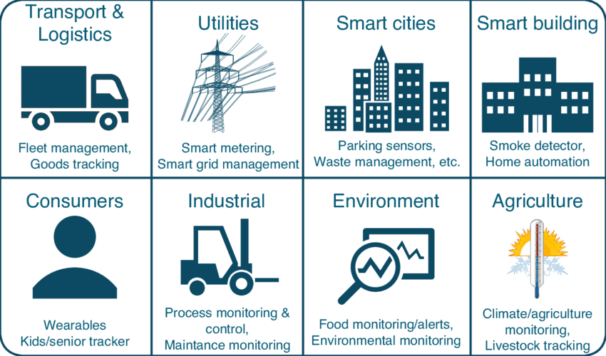
TOPIC 02 · LANDSCAPE
IoT Applications Across Industry
IoT has found its way into every conceivable field, from agriculture to aerospace.
Business Innovation with IoT · TGS-2026064711
© 2026 Tertiary Infotech Academy Pte Ltd
40

Slide 41
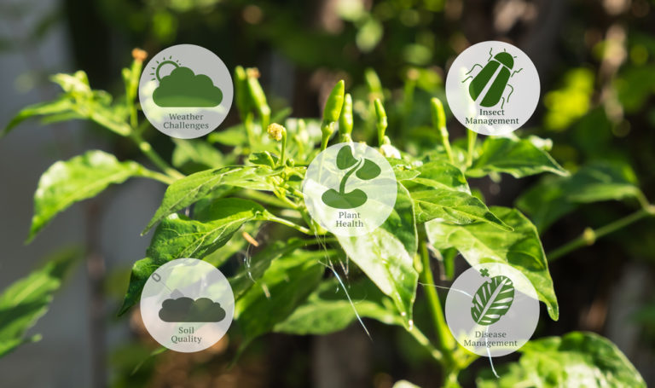
TOPIC 02 · AGRICULTURE
IoT for Agriculture
Precision agriculture: sense the soil and crop, then irrigate and fertilise to the actual need.
Business Innovation with IoT · TGS-2026064711
© 2026 Tertiary Infotech Academy Pte Ltd
41

Slide 42
TOPIC 02 · AGRICULTURE
Use Case — Agriculture
The problem
The IoT solution
The business value
• Soil and crop condition is invisible
• Water and fertiliser applied uniformly
• Decisions made from experience alone
• Soil moisture & nutrient sensing
• Weather and micro-climate data
• IBM AgroPad: instant chemical test
• Precision irrigation cuts water use
• Higher yield per hectare
• Lower input cost per tonne
Business Innovation with IoT · TGS-2026064711
© 2026 Tertiary Infotech Academy Pte Ltd
42

Slide 43
TOPIC 02 · MOBILITY & SUPPLY CHAIN
Use Case — Autonomous Vehicles & Logistics
Autonomous driving
Fleet monitoring
The business value
• Sensor fusion: radar, lidar, camera
• Driver assistance to full automation
• BMW: 30 years of development
• Location, fuel and engine telemetry
• Cold-chain temperature tracking
• Oracle IoT Fleet Monitoring
• Route and fuel optimisation
• Fewer accidents and claims
• End-to-end shipment visibility
Business Innovation with IoT · TGS-2026064711
© 2026 Tertiary Infotech Academy Pte Ltd
43

Slide 44
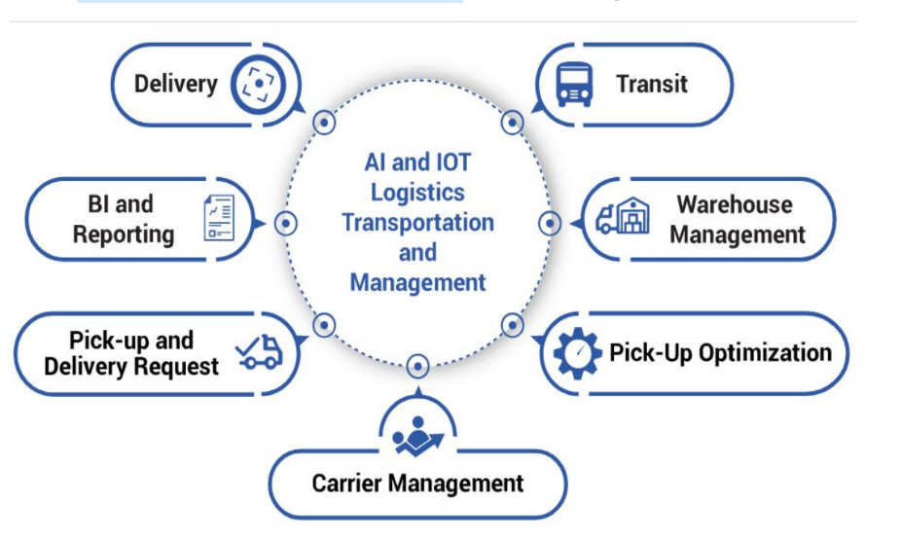
TOPIC 02 · LOGISTICS
IoT for Logistics and Fleet
Location, temperature and fuel telemetry give end-to-end shipment visibility.
Business Innovation with IoT · TGS-2026064711
© 2026 Tertiary Infotech Academy Pte Ltd
44

Slide 45
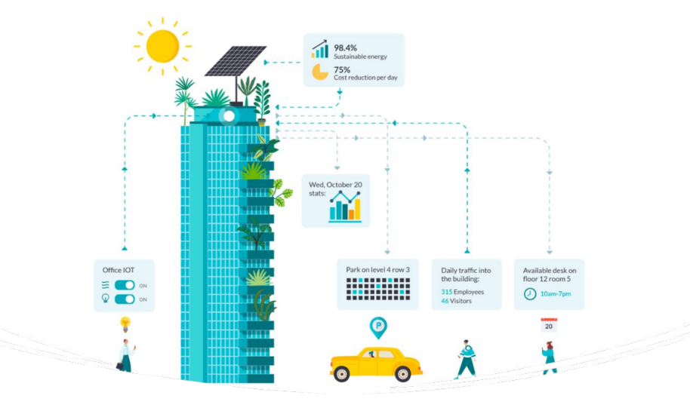
TOPIC 02 · SMART BUILDINGS
IoT for Smart Buildings
Occupancy, energy and equipment sensing cut utility cost and enable predictive maintenance.
Business Innovation with IoT · TGS-2026064711
© 2026 Tertiary Infotech Academy Pte Ltd
45

Slide 46
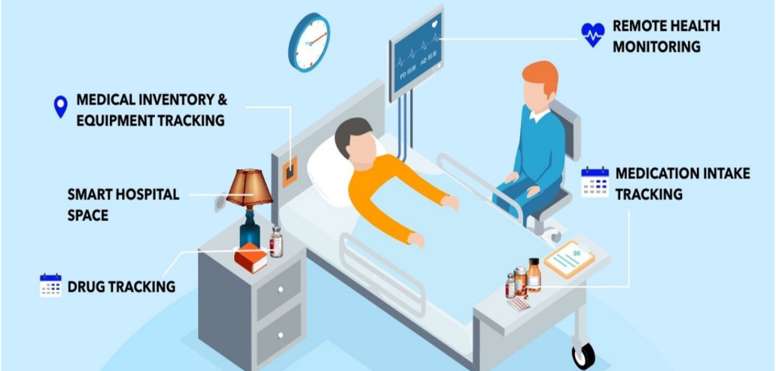
TOPIC 02 · HEALTHCARE
IoT for Healthcare
Continuous patient monitoring feeds the medical record and supports earlier intervention.
Business Innovation with IoT · TGS-2026064711
© 2026 Tertiary Infotech Academy Pte Ltd
46

Slide 47
TOPIC 02 · BUILT ENVIRONMENT, HEALTH & AERIAL
Use Case — Buildings, Healthcare & Drones
Smart buildings
Healthcare & wearables
Drones
• Occupancy and energy sensing
• Predictive lift & HVAC maintenance
• Smart washroom servicing on demand
• Continuous patient monitoring
• Philips: data feeds the EMR securely
• Earlier clinical intervention
• Aerial inspection and survey
• Singapore offshore ship delivery
• Reaches where people cannot safely go
Business Innovation with IoT · TGS-2026064711
© 2026 Tertiary Infotech Academy Pte Ltd
47

Slide 48
A2 · A REPEATABLE METHOD
How to Find an IoT Opportunity
1
2
3
4
5
▶
▶
▶
▶
Find a process that is invisible, manual or reactive today
Decide what to MEASURE and how often
Decide who or what ACTS on that reading
Quantify the cost of the current blind spot
Pilot on one asset before you scale
Business Innovation with IoT · TGS-2026064711
© 2026 Tertiary Infotech Academy Pte Ltd
48

Slide 49
TOPIC 02 · ACTIVITY
Discussion — Spot an IoT Opportunity
DISCUSSION · 15 MIN
Working from the six industry use cases, identify one process in your own organisation that is currently invisible, manual or reactive, and could be sensed instead.
1
2
3
4
Which process today relies on someone physically checking something?
What would you measure, how often, and who would act on the reading?
What is the cost of the current blind spot — downtime, spoilage, overtime, penalties?
Which of the six use cases is closest to your scenario, and what can you borrow from it?
YOUR OUTPUT One clearly stated IoT opportunity: the asset, the measurement, and the decision it improves.
Business Innovation with IoT · TGS-2026064711
© 2026 Tertiary Infotech Academy Pte Ltd
49

Slide 50
TOPIC RECAP
Recap — Potential Opportunities of IoT Innovation
• IoT opportunities exist in every sector — agriculture, mobility, logistics, buildings, health and aerial.
• The repeating pattern: sense what was invisible, then act on it automatically.
• Borrow the pattern from an adjacent industry rather than inventing from scratch.
• Start from the business pain and the cost of the blind spot, not from the technology.
Business Innovation with IoT · TGS-2026064711
© 2026 Tertiary Infotech Academy Pte Ltd
50

Slide 51
03
TOPIC 03
IoT Technology
Cloud platforms · Post data · Read & control · Analytics & visualisation · Automation
Business Innovation with IoT · TGS-2026064711
© 2026 Tertiary Infotech Academy Pte Ltd
51

Slide 52
LO3 · A3, K2 · 60 min + 90 min practical
Key Concepts — IoT Technology
Cloud for IoT
A platform ingests telemetry, stores history, visualises it and triggers actions — no servers to run.
IoTFlow
Our platform: projects, devices, tokens, dashboards, alerts and automations in one place.
1
2
Uplink: posting data
Devices POST readings over HTTP REST or publish over MQTT, authenticated by a device token.
Downlink: control
Virtual pins carry commands from the dashboard back to the device to switch a relay or set a value.
3
4
Analytics & visualisation
Number cards, gauges, charts and maps turn raw readings into an operational picture.
Automation & AI
Rules and n8n workflows notify, log and let AI summarise readings and recommend an action.
5
6
Business Innovation with IoT · TGS-2026064711
© 2026 Tertiary Infotech Academy Pte Ltd
52

Slide 53
THE CLOUD LAYER
Cloud Computing for IoT
Why the cloud
Devices are small and intermittent; the cloud gives storage, compute and availability they cannot.
What a platform does
Ingest telemetry, store history, visualise it, raise alerts and trigger actions.
1
2
No servers to run
A managed IoT platform removes the infrastructure work so you focus on the business logic.
Scales with you
One device or ten thousand — the same architecture, priced by what you actually use.
3
4
Business Innovation with IoT · TGS-2026064711
© 2026 Tertiary Infotech Academy Pte Ltd
53

Slide 54
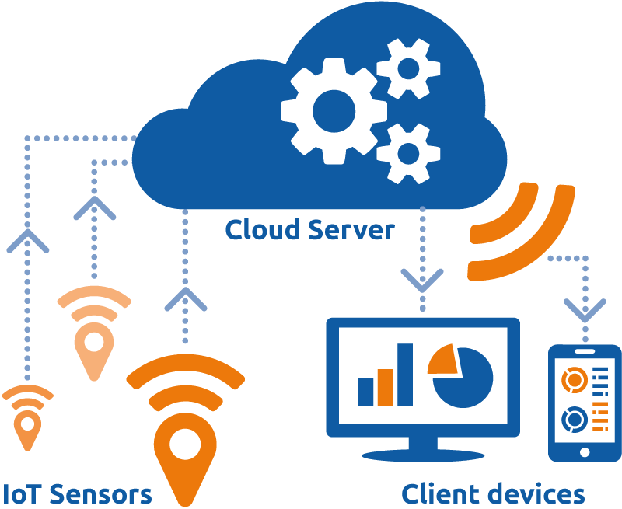
TOPIC 03 · THE CLOUD LAYER
Cloud Computing for IoT
The cloud gives constrained devices the storage, compute and availability they lack.
Business Innovation with IoT · TGS-2026064711
© 2026 Tertiary Infotech Academy Pte Ltd
54

Slide 55
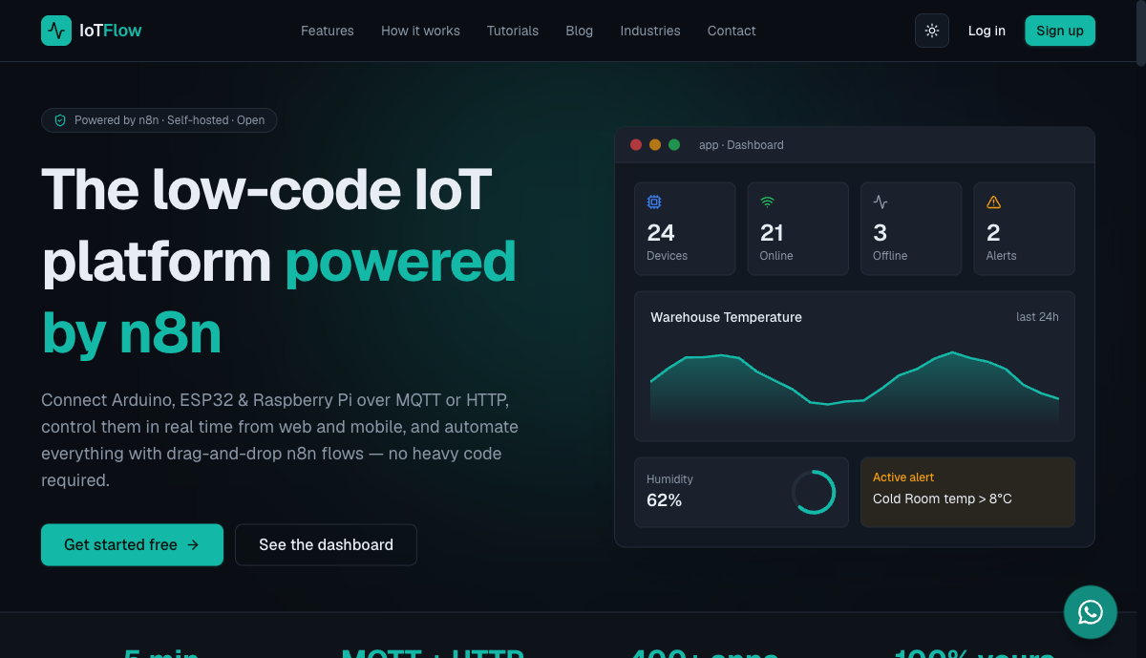
TOPIC 03 · OUR PLATFORM
IoTFlow — https://iot.tertiaryinfotech.com
The platform you will use for every lab in this course.
Business Innovation with IoT · TGS-2026064711
© 2026 Tertiary Infotech Academy Pte Ltd
55

Slide 56
https://iot.tertiaryinfotech.com
IoTFlow — Our IoT Platform
Projects
A self-contained workspace with its own devices, dashboard, alerts, map and automations.
Devices & tokens
Register a device in a guided wizard; a device token authenticates every message it sends.
1
2
HTTP & MQTT
POST JSON to a REST endpoint, or publish/subscribe over MQTT for real-time two-way traffic.
Dashboards
Number cards, gauges, charts, LED indicators and maps that refresh automatically.
3
4
Alerts & automations
Threshold and offline rules that fire a webhook into an n8n workflow.
Clients
Official Python client (pip install iotflow) and an Arduino library for ESP32/ESP8266.
5
6
Business Innovation with IoT · TGS-2026064711
© 2026 Tertiary Infotech Academy Pte Ltd
56

Slide 57
A3 · HOW DIGITISATION REACHES THE BUSINESS
The IoT Data Round Trip
1
2
3
4
5
▶
▶
▶
▶
DEVICE reads a sensor value
UPLINK posts it over HTTP or MQTT
CLOUD stores, charts and evaluates rules
DECISION — a person or an automation acts
DOWNLINK sends a command back to the device
Business Innovation with IoT · TGS-2026064711
© 2026 Tertiary Infotech Academy Pte Ltd
57

Slide 58
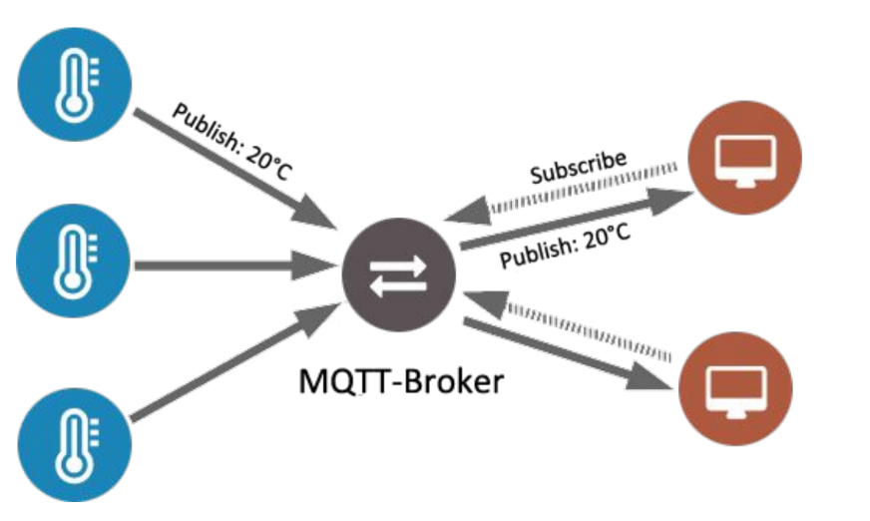
TOPIC 03 · PROTOCOLS
How MQTT Works
Publish/subscribe: devices publish to a topic and the broker delivers to every subscriber.
Business Innovation with IoT · TGS-2026064711
© 2026 Tertiary Infotech Academy Pte Ltd
58

Slide 59
TWO DIRECTIONS, TWO PURPOSES
Uplink vs Downlink
Monitoring
Control
• Uplink — telemetry
– Device → cloud
– Sensor readings and status
– HTTP POST /api/telemetry
– or MQTT publish
– This is your monitoring data
• Downlink — commands
– Cloud → device
– Switch a relay, set a value
– MQTT topic devices/<id>/down
– or HTTP state polling
– This is your automation
Business Innovation with IoT · TGS-2026064711
© 2026 Tertiary Infotech Academy Pte Ltd
59

Slide 60
ANALYTICS, VISUALISATION & AUTOMATION
Turning Data into Business Insight
Visualise
Number cards, gauges, line charts and maps make current performance obvious at a glance.
Detect
Alert rules fire the moment a reading crosses a business-meaningful threshold.
1
2
Notify
Automations push the event to email, Telegram or WhatsApp so the right person knows.
Record
Append every event to a sheet or database to build the history the business case needs.
3
4
Analyse with AI
An AI node summarises recent readings and recommends an action in plain language.
Act automatically
Close the loop — send a command back to the device with no human in the middle.
5
6
Business Innovation with IoT · TGS-2026064711
© 2026 Tertiary Infotech Academy Pte Ltd
60

Slide 61
TOPIC 03 · PRACTICAL
Hands-On Practical — 90 minutes
Four labs on IoTFlow (https://iot.tertiaryinfotech.com). Step-by-step instructions are in your Learner Guide — follow along there.
Business Innovation with IoT · TGS-2026064711
© 2026 Tertiary Infotech Academy Pte Ltd
61

Slide 62
WHAT YOU'LL DO
Hands-On Labs — IoT Technology
Labs 1–2
Lab 3
Lab 4
• Register your first IoT device
• Post business data to the cloud
• Read data back
• Remotely control the asset
• Dashboard, alerts & AI automation
• Turn data into a decision
Business Innovation with IoT · TGS-2026064711
© 2026 Tertiary Infotech Academy Pte Ltd
62

Slide 63
TOPIC 03 · HANDS-ON
Register Your First IoT Device on IoTFlow
LAB 1
Identify how digitisation is applied to a business asset by connecting it to the cloud (A3, K2).
Turn a physical asset into a digital one. You sign in to IoTFlow, create a project workspace for your business scenario, register a device through the Add Device wizard, choose how it will talk to the cloud (HTTP or MQTT), and capture the device token that authenticates every message it sends.
YOU'LL BUILD
WHY THE BUSINESS CARES
A registered IoT device in your own IoTFlow project, with its device token saved
This is the first step of digitisation: an asset that was previously invisible to the business now has an identity, an owner and a data stream that can be measured and managed.
TOOLS IoTFlow projects · Add Device wizard · Device tokens · HTTP & MQTT
Business Innovation with IoT · TGS-2026064711
© 2026 Tertiary Infotech Academy Pte Ltd
63

Slide 64
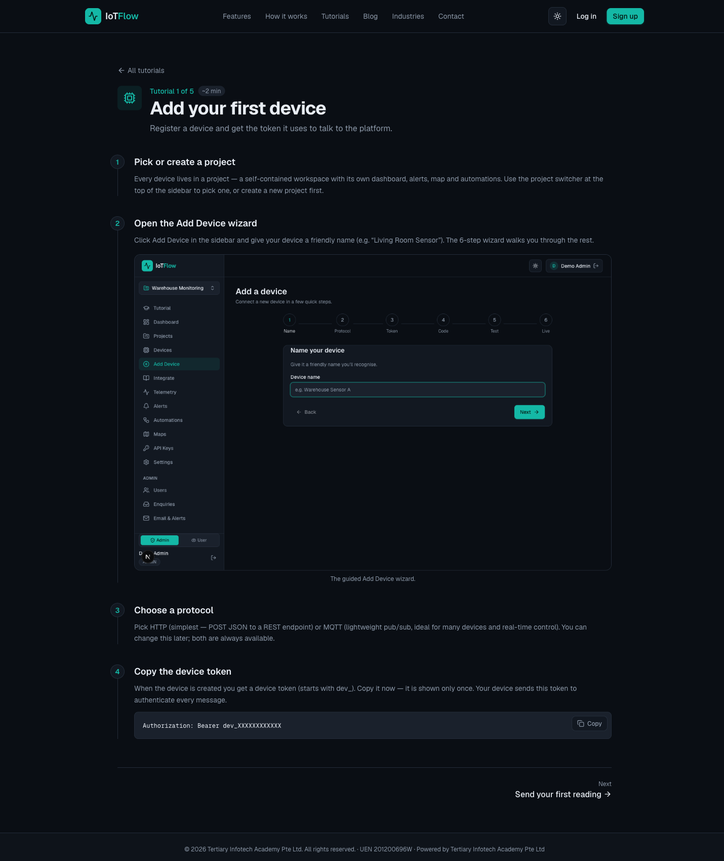
TOPIC 03 · WHAT YOU'LL SEE
Lab 1 — Register Your First IoT Device on IoTFlow
IoTFlow — A registered IoT device in your own IoTFlow project, with its device token saved
Business Innovation with IoT · TGS-2026064711
© 2026 Tertiary Infotech Academy Pte Ltd
64

Slide 65
TOPIC 03 · HANDS-ON
Post Business Data to the Cloud (HTTP & MQTT)
LAB 2
Apply digitisation by streaming operational data from the asset to the cloud (A3, K2).
Send readings to IoTFlow three different ways — cURL from any terminal, the Python client, and (optionally) an ESP32/ESP8266 over MQTT — and watch them arrive live. This is the uplink that every IoT business case depends on: without a reliable data stream there is nothing to analyse.
YOU'LL BUILD
WHY THE BUSINESS CARES
Live temperature and humidity telemetry streaming into IoTFlow from terminal and Python
Each reading is an operational fact with a timestamp. Once the stream exists, the business can ask questions it previously could not answer — how often, how long, how bad, and at what cost.
TOOLS Telemetry REST API · Python client (pip install iotflow) · MQTT broker · ESP32/ESP8266
Business Innovation with IoT · TGS-2026064711
© 2026 Tertiary Infotech Academy Pte Ltd
65

Slide 66
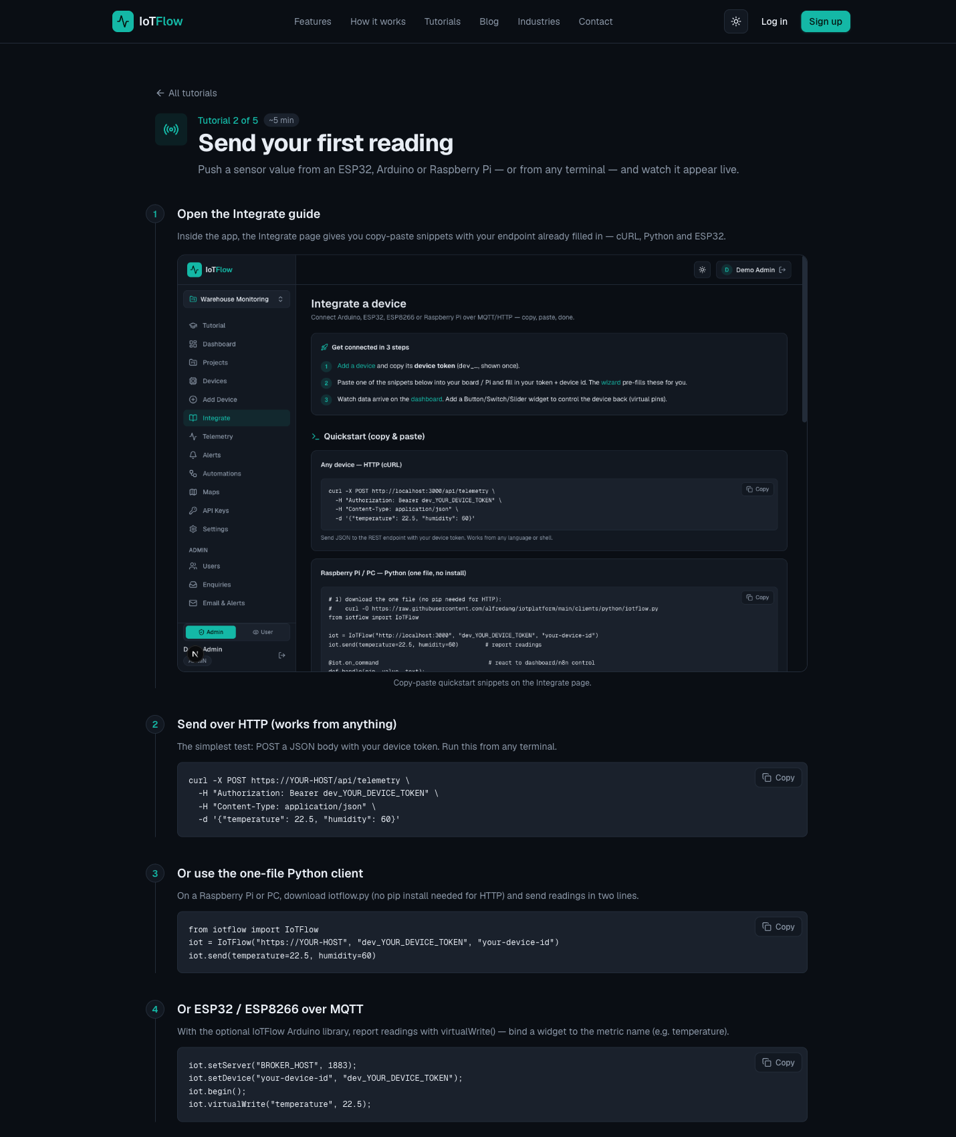
TOPIC 03 · WHAT YOU'LL SEE
Lab 2 — Post Business Data to the Cloud (HTTP & MQTT)
IoTFlow — Live temperature and humidity telemetry streaming into IoTFlow from terminal and Python
Business Innovation with IoT · TGS-2026064711
© 2026 Tertiary Infotech Academy Pte Ltd
66

Slide 67
TOPIC 03 · HANDS-ON
Read Data Back and Remotely Control the Asset
LAB 3
Close the loop between cloud data and physical action — the basis of an IoT business process (A3, K2).
Read device state back out of the cloud over the REST API and MQTT, then add Control widgets (switch, slider) bound to virtual pins and drive the device from the dashboard. Reading data is monitoring; sending commands back is automation — and that is where the labour savings appear.
YOU'LL BUILD
WHY THE BUSINESS CARES
A dashboard switch and slider that control a relay/LED on the device in real time
Monitoring tells you what happened. Control lets the system act without a person driving out to the site — this is usually the single largest line in an IoT cost-benefit case.
TOOLS REST API (GET /api/device/state) · MQTT subscribe · Control widgets · Virtual pins · @on_command
Business Innovation with IoT · TGS-2026064711
© 2026 Tertiary Infotech Academy Pte Ltd
67

Slide 68
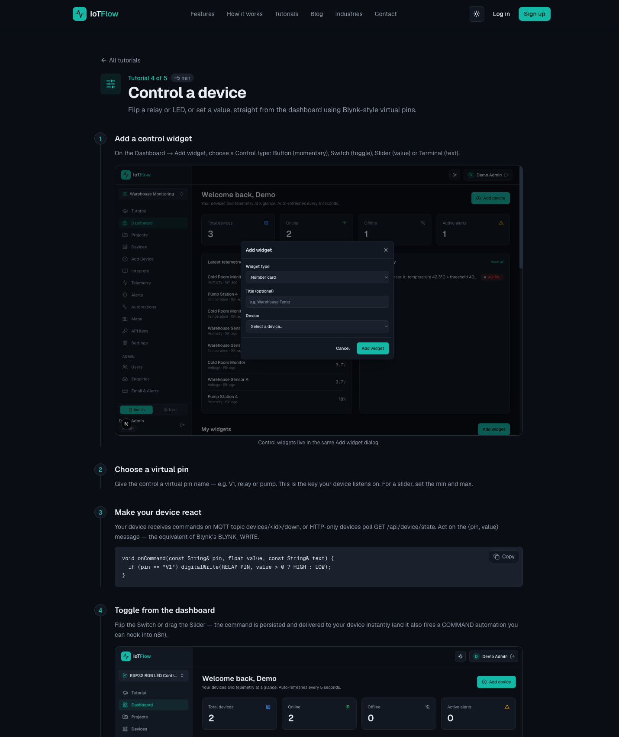
TOPIC 03 · WHAT YOU'LL SEE
Lab 3 — Read Data Back and Remotely Control the Asset
IoTFlow — A dashboard switch and slider that control a relay/LED on the device in real time
Business Innovation with IoT · TGS-2026064711
© 2026 Tertiary Infotech Academy Pte Ltd
68

Slide 69
TOPIC 03 · HANDS-ON
Turn IoT Data into Business Insight
LAB 4
Use analytics, visualisation and automation to turn raw telemetry into a business decision (A3, K2).
Build a live dashboard from your readings — number cards, gauges, charts, LED indicators and maps — then set a threshold alert and hand it to an n8n workflow that notifies the team, logs the event and asks an AI node to summarise the readings and recommend an action.
YOU'LL BUILD
WHY THE BUSINESS CARES
A monitoring dashboard plus an alert-driven n8n workflow with an AI summary and a downlink command
This is the slide the board actually sees. A dashboard makes performance visible, an alert makes it timely, and the AI summary turns a stream of numbers into a recommended action.
TOOLS Display widgets · Alert rules · IoTFlow Automations · n8n Webhook · Email/Telegram · Google Sheets · AI nodes
Business Innovation with IoT · TGS-2026064711
© 2026 Tertiary Infotech Academy Pte Ltd
69

Slide 70
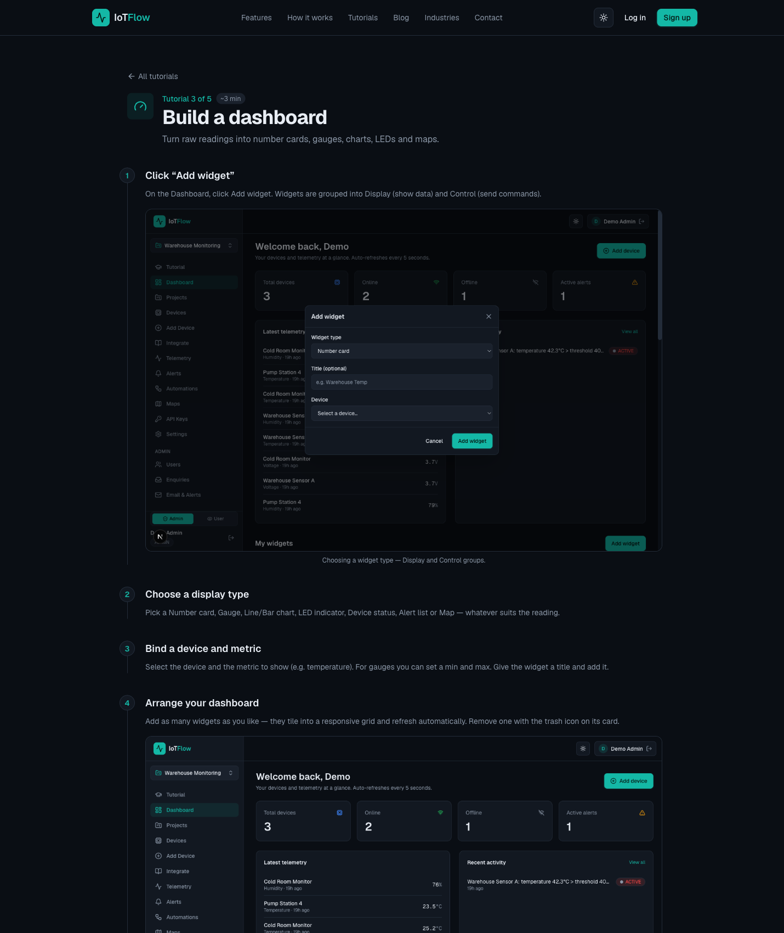
TOPIC 03 · WHAT YOU'LL SEE
Lab 4 — Turn IoT Data into Business Insight
IoTFlow — A monitoring dashboard plus an alert-driven n8n workflow with an AI summary and a downlink command
Business Innovation with IoT · TGS-2026064711
© 2026 Tertiary Infotech Academy Pte Ltd
70

Slide 71
TOPIC 03 · PRACTICAL RECAP
What the Labs Proved
Any asset can be digitised
A token and a few lines of code put a physical thing on the network.
Data arrives in seconds
The dashboard updated live as each reading was posted.
1
2
Control closes the loop
A command from the dashboard changed the device state remotely.
Insight can be automatic
A threshold fired a workflow that notified, logged and recommended an action.
3
4
Business Innovation with IoT · TGS-2026064711
© 2026 Tertiary Infotech Academy Pte Ltd
71

Slide 72
TOPIC RECAP
Recap — IoT Technology
• An IoT platform ingests telemetry, stores it, visualises it and triggers actions — with no servers to run.
• Uplink carries sensor readings to the cloud; downlink carries commands back to the device.
• Dashboards make performance visible; alert rules make problems timely.
• Automations and AI turn a stream of readings into a recommended business action.
Business Innovation with IoT · TGS-2026064711
© 2026 Tertiary Infotech Academy Pte Ltd
72

Slide 73
04
TOPIC 04
IoT Adoption
Adoption challenges · IoT security · Edge computing · Cost-benefit analysis
Business Innovation with IoT · TGS-2026064711
© 2026 Tertiary Infotech Academy Pte Ltd
73

Slide 74
LO4 · A4, K3 · 60 min
Key Concepts — IoT Adoption
Barriers to adoption
Data privacy, security, cost, skills gaps, weak standards and interoperability with legacy systems.
Why IoT security differs
Constrained devices, long unattended lifetimes and physical consequences to a breach.
1
2
Mirai botnet
Default credentials on cameras and routers built a botnet that took down much of the US east coast.
Edge computing
Processing near the source cuts latency, bandwidth and cost, and keeps sensitive data local.
3
4
Falling hardware cost
Sensor, gateway and connectivity prices keep dropping, improving the business case each year.
Cost-benefit analysis
Weigh hardware, connectivity, platform and integration against savings, uptime and new revenue.
5
6
Business Innovation with IoT · TGS-2026064711
© 2026 Tertiary Infotech Academy Pte Ltd
74

Slide 75
TOP BARRIERS TO IoT ADOPTION
Why Organisations Hold Back
Data privacy
Who owns the data, where does it live, and what does the law require?
Security
Connected devices widen the attack surface into the physical world.
1
2
Cost of implementation
Hardware, integration and change management, not just the sensors.
Knowledge gap
Teams do not know which solutions exist or how to evaluate them.
3
4
Legacy & interoperability
Existing systems do not speak the same protocols.
Unproven benefit
Uncertainty that IoT will actually deliver what was promised.
5
6
Business Innovation with IoT · TGS-2026064711
© 2026 Tertiary Infotech Academy Pte Ltd
75

Slide 76
K3 · RISK FACTORS
IoT Security — Why It Is Different
Constrained devices
Unattended & long-lived
Physical consequences
• Microcontrollers, not servers
• Often battery powered
• May not support TLS/SSL
• Run for years without supervision
• Patching is inconvenient
• Rogue devices go unnoticed
• IT breach leaks data
• IoT breach can cause harm
• Safety-critical systems at risk
Business Innovation with IoT · TGS-2026064711
© 2026 Tertiary Infotech Academy Pte Ltd
76

Slide 77
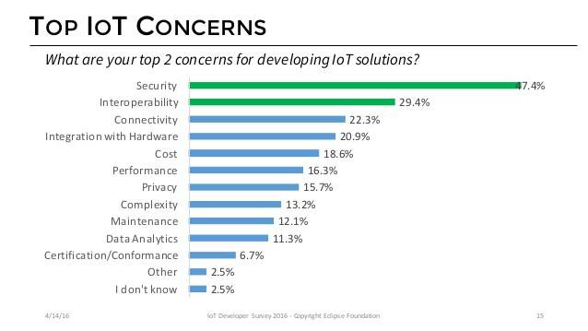
TOPIC 04 · SECURITY
IoT Security Is a Top Concern
Security and data privacy are consistently the biggest barriers to IoT adoption.
Business Innovation with IoT · TGS-2026064711
© 2026 Tertiary Infotech Academy Pte Ltd
77

Slide 78
CASE STUDY · WHY DEVICE SECURITY MATTERS
The Mirai botnet, 12 October 2016.
Default credentials on cameras and routers were harvested into a botnet whose DDoS attack took much of the US east coast offline — an unsecured device is everyone's problem.
Business Innovation with IoT · TGS-2026064711
© 2026 Tertiary Infotech Academy Pte Ltd
78

Slide 79
THE SOLUTION STACK
The Four Stages of an IoT Solution
1
2
3
4
▶
▶
▶
SENSE — devices and sensors capture the physical state
CONNECT — gateways and networks carry the data
PROCESS — cloud or edge analyses and stores it
ACT — dashboards, alerts and automations drive the decision
Business Innovation with IoT · TGS-2026064711
© 2026 Tertiary Infotech Academy Pte Ltd
79

Slide 80
K3 · WHERE SHOULD THE PROCESSING HAPPEN?
Edge vs Cloud Processing
Near the data
Central
• Edge computing
– Process at or near the device
– Lower latency — acts immediately
– Less bandwidth and lower cost
– Sensitive data stays local
– Limited compute and storage
• Cloud computing
– Process in the data centre
– Unlimited compute and history
– Easier to update and scale
– Best for analytics and AI
– Needs connectivity and bandwidth
Business Innovation with IoT · TGS-2026064711
© 2026 Tertiary Infotech Academy Pte Ltd
80

Slide 81
A4 · BUILDING THE BUSINESS CASE
Cost-Benefit Analysis of IoT
Hardware
Sensors, actuators, gateways — prices have fallen steadily year on year.
Connectivity
SIM, LoRa or WiFi; recurring per-device cost that scales with the fleet.
1
2
Platform
Subscription by device count or data volume; low-budget options exist.
Integration
Often the largest line — connecting IoT data into existing business systems.
3
4
Benefits
Labour saved, downtime avoided, energy and wastage reduced, new revenue enabled.
Payback
Compare total cost against annual benefit; pilot first to validate the assumptions.
5
6
Business Innovation with IoT · TGS-2026064711
© 2026 Tertiary Infotech Academy Pte Ltd
81

Slide 82
TOPIC 04 · ACTIVITY
Discussion — Cost-Benefit Analysis
DISCUSSION · 20 MIN
Take the opportunity you identified in Topic 2 and build a first-pass feasibility and cost-benefit case for it, including the security and privacy risks.
1
2
3
4
Costs: devices, connectivity, platform subscription, integration, installation, maintenance.
Benefits: labour saved, downtime avoided, energy or wastage reduced, new revenue enabled.
Risks: data privacy, device security, interoperability with legacy systems, skills gaps.
Roughly how long before the benefits exceed the costs — and what would break that estimate?
YOUR OUTPUT A cost-benefit summary with an estimated payback period and the top three risks.
Business Innovation with IoT · TGS-2026064711
© 2026 Tertiary Infotech Academy Pte Ltd
82

Slide 83
TOPIC RECAP
Recap — IoT Adoption
• Privacy, security, cost, skills and legacy interoperability are the main adoption barriers.
• IoT security differs from IT security: constrained, unattended devices with physical consequences.
• Edge processing cuts latency, bandwidth and privacy exposure; the cloud gives scale and analytics.
• A credible cost-benefit case counts integration and running cost, not just the hardware.
Business Innovation with IoT · TGS-2026064711
© 2026 Tertiary Infotech Academy Pte Ltd
83

Slide 84
05
TOPIC 05
IoT Implementation
Success factors · Design thinking · A 7-step action plan
Business Innovation with IoT · TGS-2026064711
© 2026 Tertiary Infotech Academy Pte Ltd
84

Slide 85
LO5 · A5, K4 · 60 min
Key Concepts — IoT Implementation
Lead with business value
Start from the business outcome IoT delivers, not from the technology itself.
Strategic alignment
The initiative must serve the business strategy and respect technology constraints.
1
2
Business process focus
Integrate IoT into existing workflows so the new way is clearly better than today.
Operating model & capability
Value networks and new skills are needed; give people a common IoT language.
3
4
Security by design
Build end-to-end security in from the start — it is a selection criterion, not an add-on.
Design thinking
Empathise, Define, Ideate, Prototype, Test — start small, prove value, then scale.
5
6
Business Innovation with IoT · TGS-2026064711
© 2026 Tertiary Infotech Academy Pte Ltd
85

Slide 86
K4 · WHAT SEPARATES SUCCESS FROM FAILURE
Six Success Factors for IoT Implementation
Business benefits
Focus on the value IoT delivers, not on what the technology can do.
Strategic alignment
Align with the business strategy and respect technology constraints.
1
2
Business process focus
Integrate into existing workflows so the new way is clearly better.
Operating model changes
Build the value network — end-to-end IoT needs close collaboration.
3
4
Capability uplift
Teach people IoT and Industry 4.0 so everyone shares a common language.
End-to-end security
Security by design becomes a criterion when choosing technology.
5
6
Business Innovation with IoT · TGS-2026064711
© 2026 Tertiary Infotech Academy Pte Ltd
86

Slide 87
A5 · A METHOD FOR INNOVATION
Design Thinking — the Stanford d.school Model
1
2
3
4
5
▶
▶
▶
▶
EMPATHISE — understand the user's real experience
DEFINE — state the problem from their point of view
IDEATE — generate many diverse possible solutions
PROTOTYPE — make it tangible enough to interact with
TEST — observe, gather feedback and refine
Business Innovation with IoT · TGS-2026064711
© 2026 Tertiary Infotech Academy Pte Ltd
87

Slide 88
THE 7-STEP ACTION PLAN
Applying Design Thinking to Your IoT Project
1
1 · Set business focus
Commit at top-management level and state the strategic goal IoT must serve.
2
2 · Introduce IoT capability
Build the team's understanding of what IoT can realistically do.
3
3 · Empathise with the user
Identify the pains and gains of the customer or operator affected.
4
4 · Ideate and select
Generate options, then select on brand values and business ambition.
5
5 · Prototype a pilot
Smallest deployment that proves value — one asset, one site, one metric.
6
6 · Identify implications
Develop and validate the business case, including risk and security.
7
7 · Pitch to decision makers
Win the coalition and the funding needed to scale beyond the pilot.
8
Then scale
Roll out on evidence from the pilot, not on optimism.
Business Innovation with IoT · TGS-2026064711
© 2026 Tertiary Infotech Academy Pte Ltd
88

Slide 89
TOPIC 05 · ACTIVITY
Discussion — Your Implementation Action Plan
DISCUSSION · 20 MIN
Apply design thinking and the success factors to turn your opportunity into a staged action plan you could actually pitch to management.
1
2
3
4
Empathise & Define: whose problem is this, and how would you state it in one sentence?
Ideate & Prototype: what is the smallest pilot that proves the value — one device, one site?
Test & scale: what measurable result would justify rolling it out further?
Which success factor is weakest in your organisation today, and how will you address it?
YOUR OUTPUT A staged action plan: pilot scope, success measure, owner, and the case for scaling.
Business Innovation with IoT · TGS-2026064711
© 2026 Tertiary Infotech Academy Pte Ltd
89

Slide 90
TOPIC RECAP
Recap — IoT Implementation
• Lead with business value and align the initiative with the business strategy.
• Integrate IoT into existing processes; build capability and the value network around it.
• Design security in from the start — it is a selection criterion, not an afterthought.
• Use design thinking: empathise, define, ideate, prototype, test — pilot before you scale.
Business Innovation with IoT · TGS-2026064711
© 2026 Tertiary Infotech Academy Pte Ltd
90

Slide 91
WRAP-UP
Course Summary & Next Steps
Business Innovation with IoT · TGS-2026064711
© 2026 Tertiary Infotech Academy Pte Ltd
91

Slide 92
LEARNING OUTCOMES
What You Achieved Today
1
LO1 · Business models
Compared your current business model against IoT-enabled models.
2
LO2 · Opportunities
Explored IoT use cases across six industries and found one of your own.
3
LO3 · How IoT works
Registered a device, posted data, controlled it remotely and built a dashboard.
4
LO4 · Costs & benefits
Weighed adoption barriers, security risk and the cost-benefit case.
5
LO5 · Implementation
Applied design thinking and the success factors to a staged action plan.
Business Innovation with IoT · TGS-2026064711
© 2026 Tertiary Infotech Academy Pte Ltd
92

Slide 93
AFTER TODAY
Your Next Steps
Keep your IoTFlow project
Your devices, dashboard and automations stay available after the course.
Run the pilot you designed
Start with one asset and one metric — prove the value before scaling.
1
2
Revisit the Learner Guide
Every lab's step-by-step instructions are there for you to repeat.
Explore the tutorials
More platform walkthroughs at https://iot.tertiaryinfotech.com/tutorials
3
4
Business Innovation with IoT · TGS-2026064711
© 2026 Tertiary Infotech Academy Pte Ltd
93

Slide 94
CONTINUE YOUR LEARNING
Recommended Courses
• WSQ - Internet of Things (IoT) Fundamental for Beginners
• WSQ - Mastering Raspberry Pi: Hands-On Practical Applications for Beginners
• WSQ - Practical Electronics Design with Arduino Microcontroller
• WSQ - Hands-On Guide to IoT Development with Microcontrollers
• Browse the full catalogue at www.tertiarycourses.com.sg
Business Innovation with IoT · TGS-2026064711
© 2026 Tertiary Infotech Academy Pte Ltd
94

Slide 95
SUMMARY
Summary & Q&A
• IoT connects physical assets so the business can measure what used to be invisible.
• The opportunity is a business model change, not just a technology deployment.
• Adoption succeeds when value, process integration, capability and security are addressed together.
• Any questions before the assessment?
Business Innovation with IoT · TGS-2026064711
© 2026 Tertiary Infotech Academy Pte Ltd
95

Slide 96
ASSESSMENT · 90 MINUTES TOTAL
Final Assessment
WA (Q&A) — 75 min
OQ — 15 min
Before you begin
• Short-answer questions
• Assesses abilities A1–A5
• 15 minutes per ability
• Open book
• Oral questioning
• Assesses knowledge K1–K4
• 1:1 with the assessor
• Open book
• Take the Assessment digital attendance
• Complete the TRAQOM survey
• Slides + Learner Guide allowed
• Submit as directed by your assessor
Business Innovation with IoT · TGS-2026064711
© 2026 Tertiary Infotech Academy Pte Ltd
96

Slide 97
ON ASSESSMENT DAY
Assessment Flow
1
2
3
4
5
▶
▶
▶
▶
TRAQOM survey — scan the QR code on the LMS
Assessment digital attendance — scan the SSG QR
Sit the WA (Q&A) — 75 min, open book
Oral Questioning — 15 min, 1:1 with the assessor
Sign the Assessment Summary Record
Business Innovation with IoT · TGS-2026064711
© 2026 Tertiary Infotech Academy Pte Ltd
97

Slide 98
TRAQOM · SSG DIGITAL ATTENDANCE
Digital Attendance & TRAQOM Survey (Mandatory)
Assessment attendance
Take the Assessment digital attendance before you begin — scan the SSG QR code.
Cert & TRAQOM survey
Complete the mandatory survey at https://lms-tms.tertiaryinfotech.com/
1
2
Your certificate
Your certificate is issued through the LMS once you are assessed Competent.
75% minimum
At least 75% attendance is required to be eligible for assessment and funding.
3
4
Business Innovation with IoT · TGS-2026064711
© 2026 Tertiary Infotech Academy Pte Ltd
98

Slide 99
WE'RE HERE TO HELP — DURING AND AFTER THE CLASS
Support
Email
enquiry@tertiaryinfotech.com
Telephone
+65 6100 0613
1
2
Website
www.tertiarycourses.com.sg
LMS / TMS portal
https://lms-tms.tertiaryinfotech.com
3
4
Business Innovation with IoT · TGS-2026064711
© 2026 Tertiary Infotech Academy Pte Ltd
99

Slide 100
SEE YOU AT THE NEXT COURSE
Thank You!
You can now explore, evaluate and implement business innovation opportunities with IoT.
Business Innovation with IoT · TGS-2026064711
© 2026 Tertiary Infotech Academy Pte Ltd
100

